Slide 1


Homelessness, Housing,
and Public Service
Presentation for Soc. 126 – Urban Society
Chuck Flacks
Homelessness Services Coordinator | City of Goleta

Slide 2
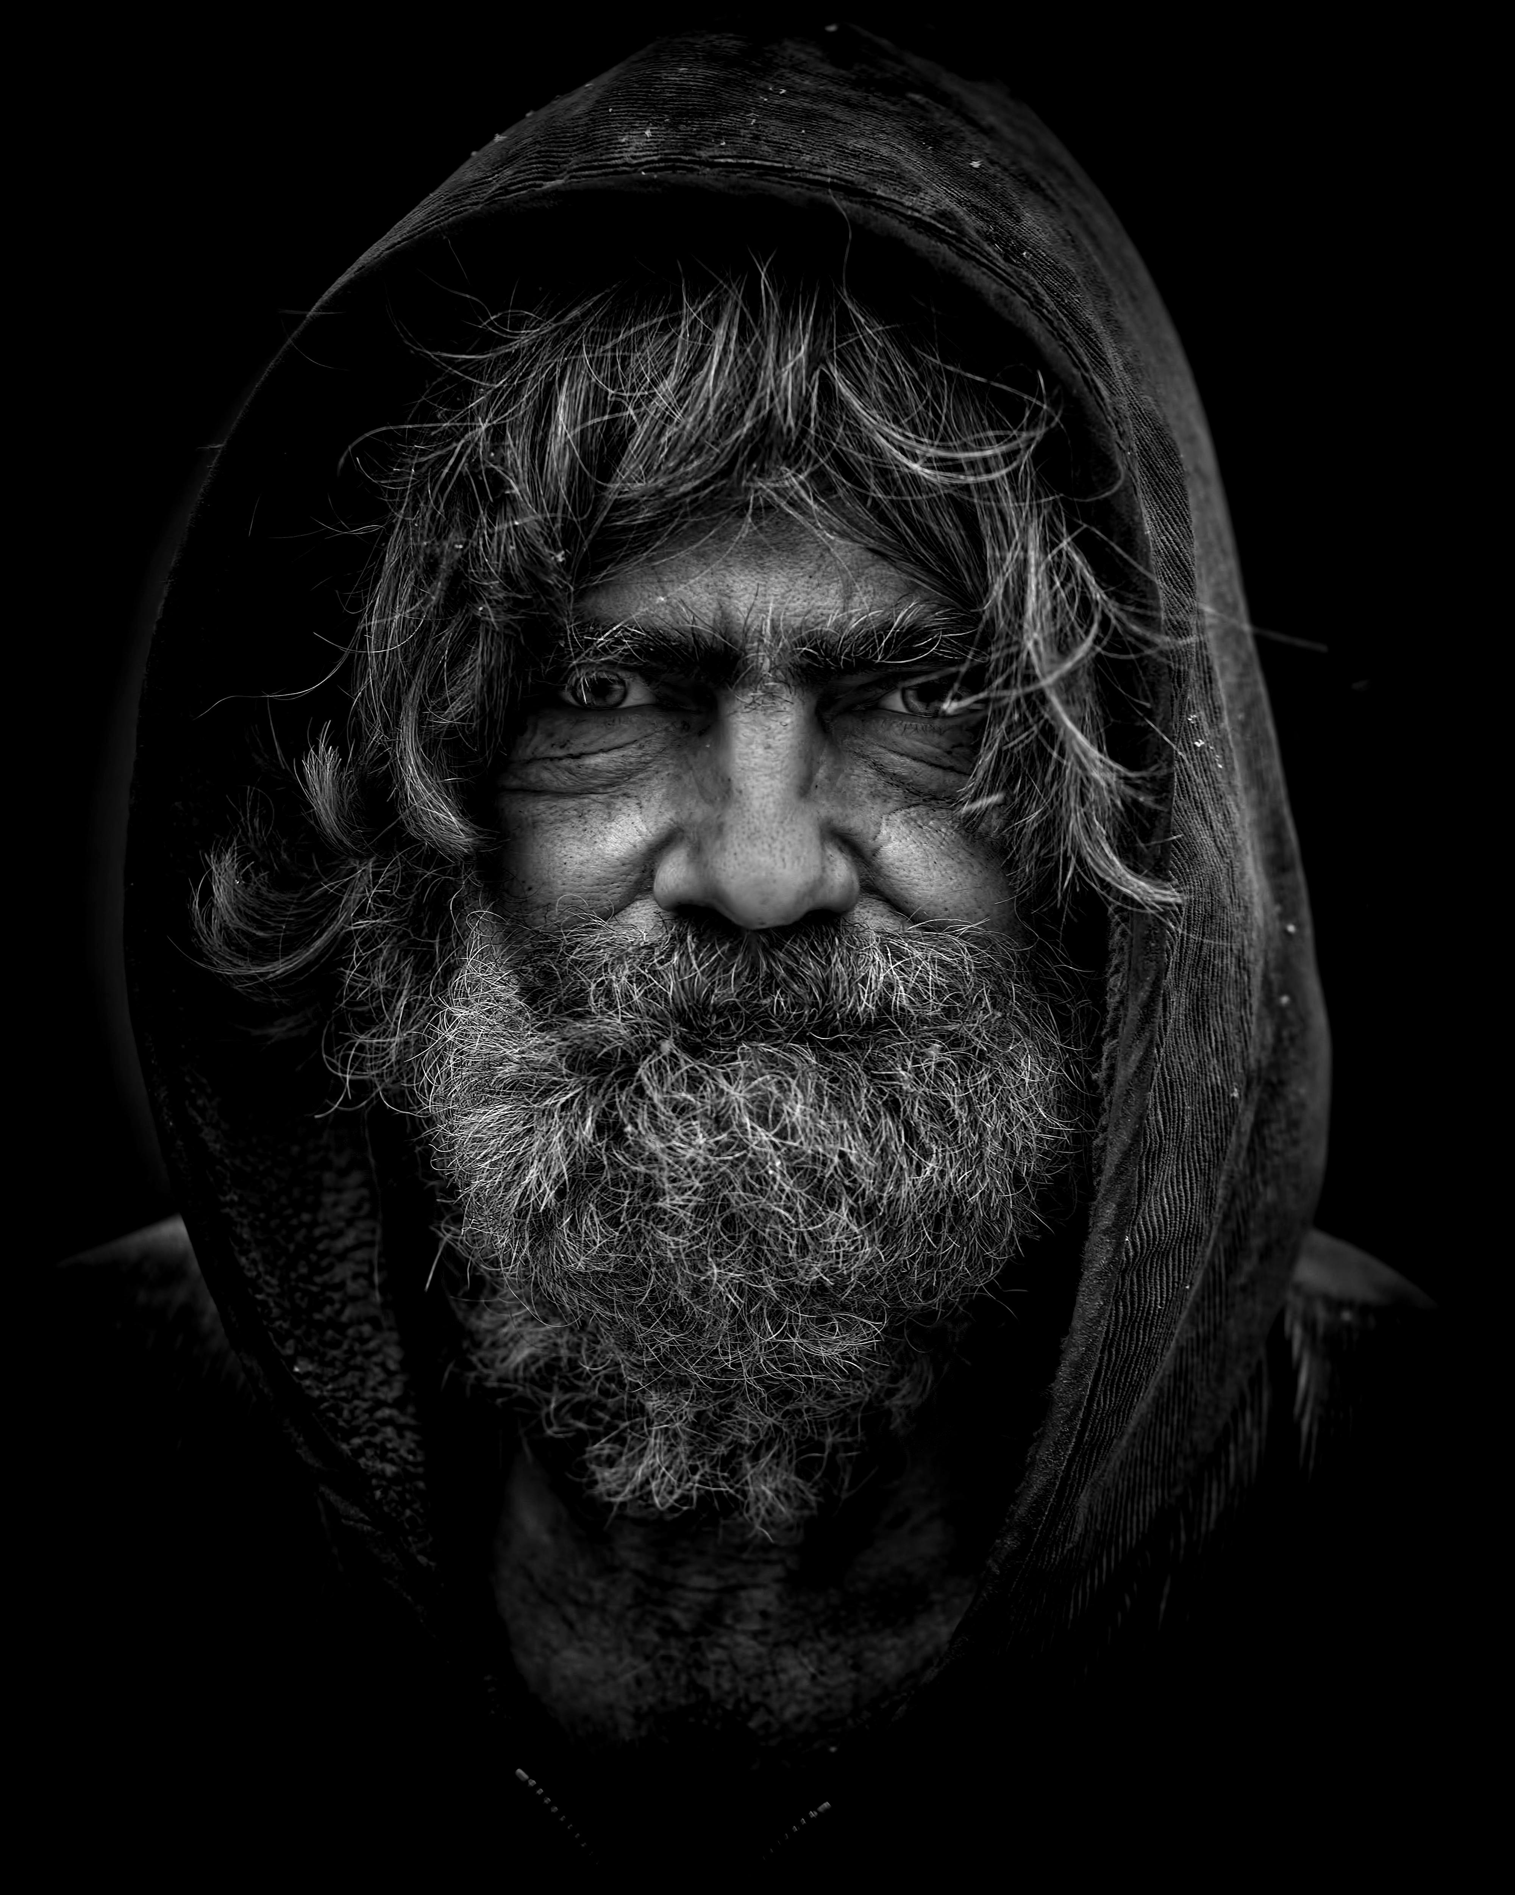
Let Me Tell You About Sarge

Slide 3
“Sarge”
Years on the street
  Drug addiction
  Fighting at the shelter
  Kicked out. More than once.

Slide 4
Then One Day…
He looked me in the eye
  Grabbed my forearm — warrior style
  Said he was ready
  He sobered up

Slide 5
Two Months Later
Placed into permanent housing
  Stability
  A different trajectory

Slide 6
Lesson for Public Service
Never give up on people
  Find common ground in their humanity
  Offer realistic and attractive solutions
  Change is possible when systems stay open

Slide 7
Myths About Homelessness in California
Source: Marisa Kendall, CalMatters
  November 27, 2024

Slide 8
Myth #1
Most homeless people come here from somewhere else
  Fact: 77% of people in Santa Barbara County
  were living here when they became homeless
  Nice weather is not the cause

Slide 9
Myth #2
Everyone living on the street is addicted or mentally ill
  Fact: 27% report serious mental illness (UCSF study)
  56% report regular methamphetamine use
  Tell 'musical chairs' story here

Slide 10

Homelessness Is
Like Musical Chairs
There are fewer affordable housing units than people who need them.
  When the music stops, someone is left without a chair.
  Job loss. Illness. Rent increase. Divorce.
  The problem isn’t the person.
  The problem is the number of chairs.

Slide 11
Myth #3
Most people on the street are veterans
  Fact: Veterans are overrepresented
  But veteran homelessness in SB County dropped 60%
  Targeted funding works

Slide 12
Myth #4
People who are homeless don’t work
  Fact: Most want jobs
  42% in Goleta have earned income
  46% are disabled

Slide 13
Myth #5
People who are homeless don’t want shelter or housing
  Fact: The vast majority want solutions
  Trust takes time to build
  A small number remain resistant — but most engage when approached with dignity

Slide 14
Myth #6
If you want to help, leave food at an encampment
  Fact: Uncoordinated donations can create trash, flies, and rats
  Without distribution, supplies can overwhelm a site
  Best help: Partner with organizations doing structured outreach

Slide 15
Myth #7
California cities are dumping people elsewhere with one-way bus tickets
  Fact: Relocation & reunification can be effective
  Ethical programs ensure a verified connection to family or services
  The goal is a meaningful handoff — not displacement

Slide 16
The New Face of Homelessness
Vehicle living is now one of the most common forms of homelessness
  On any given night in Goleta:
  ≈ 200 vehicles have someone living inside
  Often working. Often local. Often invisible.

Slide 17
Sources of the Problem
1. Housing
  Rents rise faster than wages
  Extremely low vacancy rates
  Not enough units for extremely low-income households
  2. Lack of Support Services
  Behavioral health capacity gaps
  Substance use treatment shortages
  Insufficient prevention & early intervention

Slide 18
Discussion: Why Is Housing So Expensive in California?
Supply has not kept up with demand
  Zoning limits density in many communities
  Lengthy permitting & environmental review
  High land and construction costs
  Local resistance to new development

Slide 19
So What’s the Solution?
Build more housing — at all income levels
  Streamline permitting and zoning reform
  Invest in deeply affordable units
  Expand rental assistance & prevention
  Strengthen behavioral health infrastructure

Slide 20
For You (Future Public Servants)
Would you support more housing in your own neighborhood?
  What tradeoffs are you willing to make?
  What level of government should lead?
  How do we balance compassion and order?

Slide 21
Why Get Into This Work?
Because it matters — deeply
  You see systems up close
  You help shape policy, not just debate it
  You witness real human transformation
  You get to build solutions that last

Slide 22
The Honest Truth
It is slow
  It is political
  It can be frustrating
  Progress rarely makes headlines
  But when it works — it changes lives

Slide 23
How Do You Do It?
Start local — internships, commissions, nonprofits
  Learn budgets and data (they matter more than slogans)
  Build relationships across differences
  Stay curious, not cynical
  Protect your integrity

Slide 24
Public Service Is Not About
Being a Hero
It’s about being competent
  It’s about staying when things are hard
  It’s about respecting complexity
  And refusing to give up on people

Slide 25
Kindness Changes Lives
And competence makes kindness sustainable.

Slide 26
Vehicle Living Is the New Face
of Homelessness
≈ 200 vehicles on a given night in Goleta

Slide 27
Housing Is the Core Issue
Supply. Zoning. Cost. Policy.

Slide 28
Human Change Is Possible
It starts with trust.

Slide 29
KINDNESS
CHANGES
LIVES

